Slide 1
Introduction to Page Ranking
Ramesh Ragala
Assistant Professor (Senior)
VIT Chennai

Slide 2
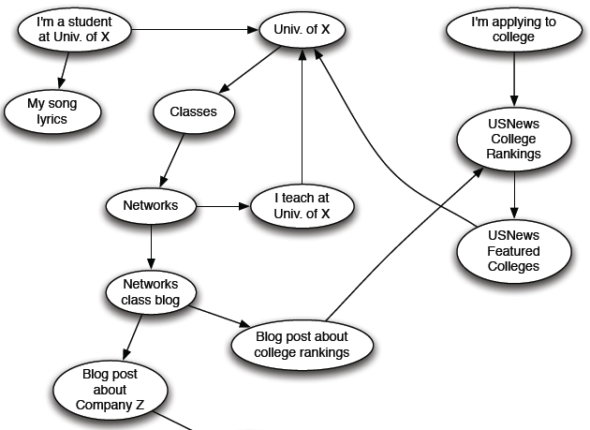
Page Ranking
Web as a Directed Graph:

Slide 3
Page Ranking
Page Ranking → (This term came form Larry Page)google innovation
Page Ranking was the essential technique for a search engine
There are many search engines before google search engine.
They worked by crawling the WEB and listing the terms found in the page. → inverted Index is used.
presence of a term in a header of the page made the page more relevant than would the presence of the term in ordinary text
large numbers of occurrences of the term would add to the assumed relevance of the page.

Slide 4
Page Ranking
Example: (unethical people to fool search engines)
If you were selling shirts on web, all you care about was that people would see your webpage, regardless of what they are looking for.
Trick: add term “movie” in your page more than 1000 times.
When the user issued a search query with a term “movie” , the search engine would list your page first.
Problem: prevention of occurring of term “movie”
Use background color to characters font color

Slide 5
Page Ranking
Term Spam:
Techniques for fooling search engines into believing your page is about something it is not.
The ability of term spammers to operate so easily rendered early search engines almost useless.
Basic Idea: Search engine believes what other pages say about you instead of what you say about yourself.
Google introduced two techniques to overcome that
1. Page Rank
2. The content of a page was judged not only by the terms appearing on that page, but by the terms used in or near the links to that page.

Slide 6
Page Ranking
PageRank was used to simulate where Web surfers, starting at a random page, would tend to congregate if they followed randomly chosen outlinks from the page at which they were currently located, and this process were allowed to iterate many times.
Pages that would have a large number of surfers were considered more “important” than pages that would rarely be visited.
Google prefers important pages to unimportant pages when deciding which pages to show first in response to a search query.

Slide 7
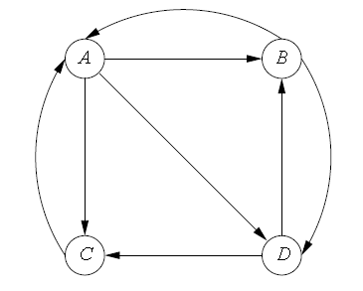
Page Ranking
PageRank is a function that assigns a real number to each page in the Web.
Higher the PageRank → more important
There is not a single fixed algorithm for assignment of PageRank.
Basic PageRank → Idealized PageRank.
Suppose Random surfer starts at A.
There are links to B,C and D.

Slide 8
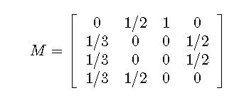
Page Ranking
Transition Matrix (M):
To describe what happens to random surfers after one step.
This matrix-M has n-rows and columns, if there are n-pages.
The element m_{ij} in row-i and column-j has value 1/k if page-j has k-arcs out, and one of them is to page-i. Otherwise, m_{ij} = 0.

Slide 9
Page Ranking
Transition Matrix:
The first column express that, a surfer has at A has 1/3 probability of next being at each other pages.
The second column expresses the fact that a surfer at B has a 1/2 probability of being next at A and the same of being at D.
The third column says a surfer at C is certain to be at A next.
The last column says a surfer at D has a 1/2 probability of being next at B and the same at C.

Slide 10
Page Ranking
The probability distribution for the location of a random surfer can be described by a column vector whose j^{th} component is the probability that the surfer is at page-j.
This probability is the idealized PageRank function.

Slide 11
Page Ranking
Suppose we start a random surfer at any of the n-pages of the Web with equal probability.
Then the initial vector v₀ will have 1/n for each component.
If M is the transition matrix of the Web, then after one step, the distribution of the surfer will be Mv₀
After two steps it will be M(Mv₀) = M²v₀, and so on.
In general, multiplying the initial vector v₀ by M a total of i-times will give us the distribution of the surfer after i-steps

Slide 12
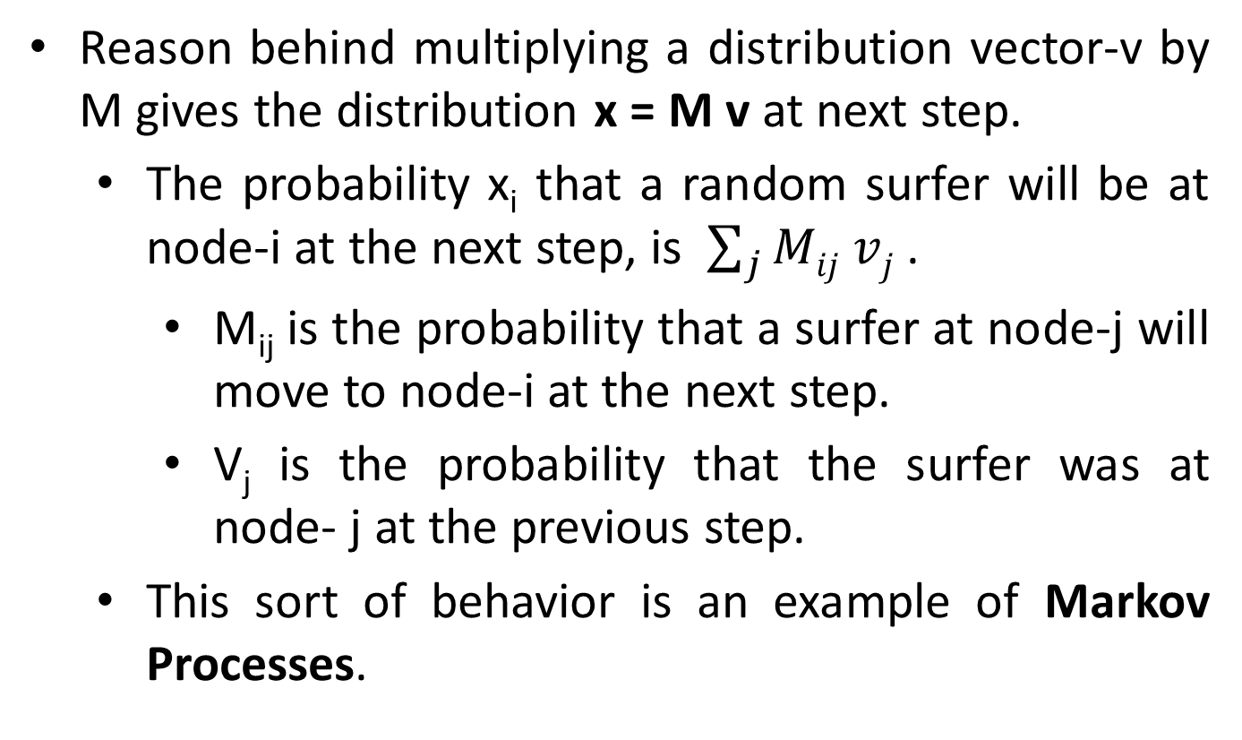
Page Ranking

Slide 13
Page Ranking score
B
38.4
C
34.3
A
3.3
D
3.9
E
8.1
F
3.9
1.6
1.6
1.6
1.6
1.6

Slide 14
Page Ranking
The distribution of the surfer approaches a limiting distribution v that satisfies v = Mv, provided two conditions are met:
The graph is strongly connected.
There are no dead ends.
The limiting v is a Eigen vector of M.
An eigenvector of a matrix M is a vector v that satisfies v = λMv for some constant eigenvalue λ.

Slide 15
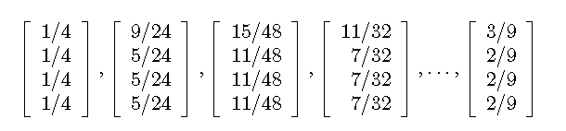
Page Ranking
Example: (Previous example)
There are four nodes, the initial vector v₀ has four components → each 1/4.
The sequence of approximations to the limit that we get by multiplying at each step by M is:

Slide 16
Page Ranking
Problems need to avoid:
Dead end → a page that has no links out
Spider Traps → groups of pages that all have outlinks but they never link to any other pages.
These two problems can be solved using “Taxation”.
we assume a random surfer has a finite probability of leaving the Web at any step, and new surfers are started at each page.

Slide 17
Page Ranking
Avoiding Dead ends:
If we allow dead ends, the transition matrix of the Web is no longer stochastic → sum of columns will be zero not one.
A matrix whose column sums are at most 1 is called substochastic.

Slide 18
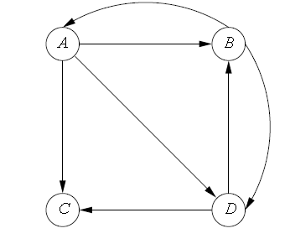
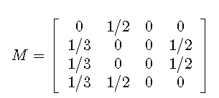
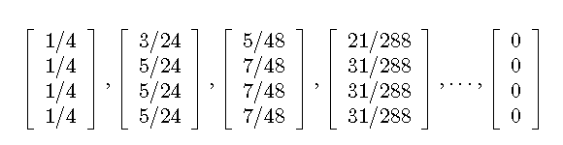
Page Ranking
Avoiding Dead ends:
Example:

Slide 19
Page Ranking
Avoiding Dead ends:
Two approaches:
First approach:
Drop the dead ends from the graph, and also drop their incoming arcs.
Doing so may create more dead ends, which also have to be dropped, recursively.
Finally, we will end up with strongly connected component
Second approach:
Taxation

Slide 20
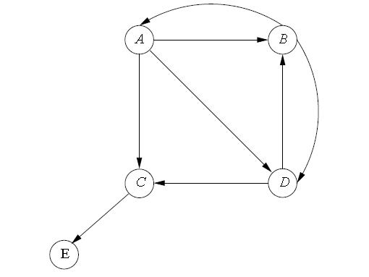
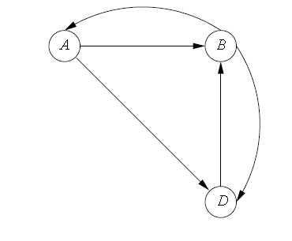
Page Ranking
Avoiding Dead ends:
First Approach: example
After removing dead ends
Original Graph

Slide 21
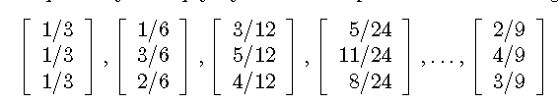
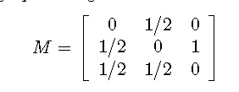
Page Ranking
Avoiding Dead ends:
First Approach: example
Matrix after removing dead ends
Sequence of Vectors

Slide 22
Page Ranking
Avoiding Dead ends:
First Approach: example
In this example:
The PageRank of A is 2/9
The PageRank of B is 4/9
The PageRank of D is 3/9
What about PageRank of C and E????
Computation of PageRank of deleted nodes will done in the order opposite to that in which they were deleted.
C was the node deleted at end. → computation of C has to be done first.

Slide 23
Page Ranking
Avoiding Dead ends:
First Approach: example
C was the node deleted at end. → computation of C has to be done first.
The predecessors are A and D.
A has three successors, so it contributes 1/3 of its PageRank to C.
Page D has two successors, so it contributes half its PageRank to C.
PageRank of C = 1/3 * 2/9 + ½*3/9 = 13/54
PageRank of E = PageRank of C (since only one predecessors and that to from C only)

Slide 24
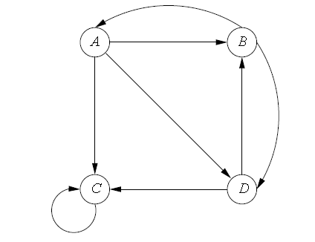
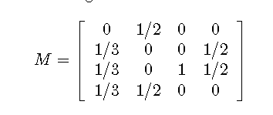
Page Ranking
Avoiding Dead ends and Spider traps in graph:
Second Approach: Taxation
a spider trap is a set of nodes with no dead ends but no arcs out.
These structures can appear intentionally or unintentionally on the Web.
A graph with one node spider trap and its transition matrix

Slide 25
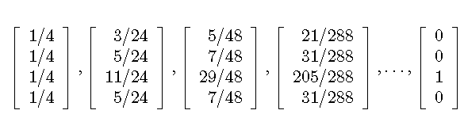
Page Ranking
Avoiding Dead ends and Spider traps in graph:
Second Approach: Taxation
Page rank at C, since once there a random surfer can never leave.
Page Rank Computation

Slide 26
Page Ranking
Avoiding Dead ends and Spider traps in graph:
Second Approach: Taxation
Modify the calculation of PageRank by allowing each random surfer a small probability of teleporting to a random page, rather than following an out-link from their current page.
The iterative step, where we compute a new vector estimate of PageRanks v’ from the current PageRank estimate v and the transition matrix M is
β is a chosen constant, range from 0.8 to 0.9
e is a vector of all 1’s with appropriate number of components
n is the number of nodes in the web graph
V’ = βMv + (1-β)e/n

Slide 27
Page Ranking
Avoiding Dead ends and Spider traps in graph:
Second Approach: Taxation
If the graph does not have dead ends
Surfer as deciding either to follow a link or teleport to a random page.
If the graph does have dead ends
There is a third possibility, which is that the surfer goes nowhere.

Slide 28
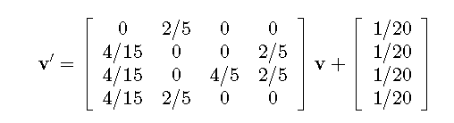
Page Ranking
Avoiding Dead ends and Spider traps in graph:
Second Approach: assume β = 0.8 in this example

Slide 29
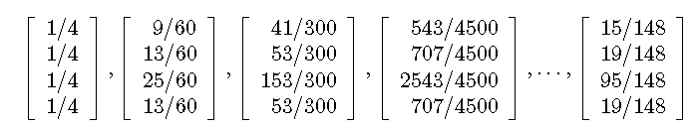
Page Ranking
Avoiding Dead ends and Spider traps in graph:
Second Approach: assume β = 0.8 in this example
Few Iterations

Slide 30
Computing Page Ranking
Properties of PageRank
Can be computed iteratively
Effects at each iteration are local
Sketch of algorithm:
Start with seed PRi values
Each page distributes PRi “credit” to all pages it links to
Each target page adds up “credit” from multiple in-bound links to compute PRi+1
Iterate until values converge

Slide 31
Computing Page Ranking
Properties of PageRank
Can be computed iteratively
Effects at each iteration are local
Sketch of algorithm:
Start with seed PRi values
Each page distributes PRi “credit” to all pages it links to
Each target page adds up “credit” from multiple in-bound links to compute PRi+1
Iterate until values converge

Slide 32
Sample PageRank Iteration (1)
Iteration 1
n₂ (0.2)
n₂ (0.166)
n₁ (0.2)
0.1
0.1
0.1
n₁ (0.066)
0.1
0.066
0.066
0.066
n₅ (0.2)
n₃ (0.2)
n₅ (0.3)
n₃ (0.166)
0.2
0.2
n₄ (0.2)
n₄ (0.3)

Slide 33
Sample PageRank Iteration (2)
Iteration 2
n₂ (0.166)
n₂ (0.133)
n₁ (0.066)
0.033
0.083
0.083
n₁ (0.1)
0.033
0.1
0.1
0.1
n₅ (0.3)
n₃ (0.166)
n₅ (0.383)
n₃ (0.183)
0.3
0.166
n₄ (0.3)
n₄ (0.2)

Slide 34
PageRank in MapReduce
n₁ [n₂, n₄]
n₂ [n₃, n₅]
n₃ [n₄]
n₄ [n₅]
n₅ [n₁, n₂, n₃]
n₁ [n₂, n₄]
n₂ [n₃, n₅]
n₃ [n₄]
n₄ [n₅]
n₅ [n₁, n₂, n₃]
Map
n₂
n₄
n₃
n₅
n₄
n₅
n₁
n₂
n₃
n₁
n₂
n₂
n₃
n₃
n₄
n₄
n₅
n₅
Reduce
n₁ [n₂, n₄]
n₂ [n₃, n₅]
n₃ [n₄]
n₄ [n₅]
n₅ [n₁, n₂, n₃]

Slide 35
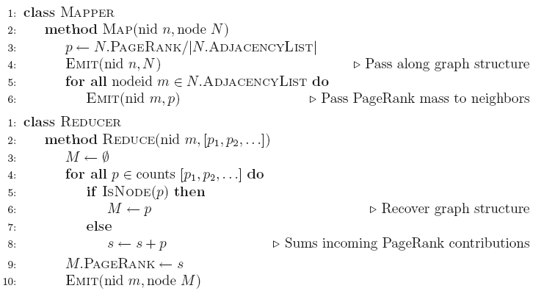
Page Ranking Pseudo Code

